Slide 1



Introduction
George Mount, Data Analyst & Educator at Stringfest Analytics
George works as an independent analyst and data analytics educator with the goal to help clients manage their data so they think more creatively. He serves as a technical expert and lead curriculum developer for Thinkful’s data analytics program and is the instructor of the DataCamp course “Survey and Measure Development in R.” George blogs about data, innovation, and career development at georgejmount.com. He holds a master’s degree in information systems with a certificate of achievement in quantitative methods from Case Western Reserve University.

Slide 2


SQL-Powered Excel for Business Analytics
Month/Year

Slide 3
Objectives for today
The basics of relational databases and SQL’s role

Slide 4
Objectives for today
The basics of relational databases and SQL’s role
The foundational commands used for reading data from one or more tables in a database

Slide 5
Objectives for today
The basics of relational databases and SQL’s role
The foundational commands used for reading data from one or more tables in a database
Schemas, primary keys and foreign keys: what makes relational databases “relational.”

Slide 6
Augment your Excel skills
Use SQL to query a database to extract useful information

Slide 7
Augment your Excel skills
Use SQL to query a database to extract useful information
Explore basic commands and functions of SQL

Slide 8
Augment your Excel skills
Use SQL to query a database to extract useful information
Explore basic commands and functions of SQL
Extract data and work with queries to pull the data you need for your analysis

Slide 9
Excel and SQL for Business Analytics
What is a database and when would you use it?

Slide 10
What is a spreadsheet and when would you use it?
Good for...
Browsing data

Slide 11
What is a spreadsheet and when would you use it?
Good for...
Browsing data
Entering/editing data

Slide 12
What is a spreadsheet and when would you use it?
Good for...
Browsing data
Entering/editing data
Flexible data structuring

Slide 13
What is a spreadsheet and when would you use it?
Good for...
Browsing data
Entering/editing data
Flexible data structuring
Quick, visual data analysis on small datasets

Slide 14
What is a spreadsheet and when would you use it?
Good for...
Not so much at...
Browsing data
Entering/editing data
Flexible data structuring
Quick, visual data analysis on small datasets
Archiving data

Slide 15
What is a spreadsheet and when would you use it?
Good for...
Not so much at...
Browsing data
Entering/editing data
Flexible data structuring
Quick, visual data analysis on small datasets
Archiving data
Big data

Slide 16
What is a spreadsheet and when would you use it?
Good for...
Not so much at...
Browsing data
Entering/editing data
Flexible data structuring
Quick, visual data analysis on small datasets
Archiving data
Big data
Interfacing data

Slide 17
What is a spreadsheet and when would you use it?
Good for...
Not so much at...
Browsing data
Entering/editing data
Flexible data structuring
Quick, visual data analysis on small datasets
Archiving data
Big data
Interfacing data
Structured data across multiple datasets

Slide 18
Relational databases
1970s origins...

Slide 19






Relational databases
1970s origins…
Still with us today!

Slide 20
What relational database system does your organization use?
 | PostgreSQL
B. | Oracle
C. | SQL Server
D. | Microsoft Access
E. | Other/don’t know

Slide 21
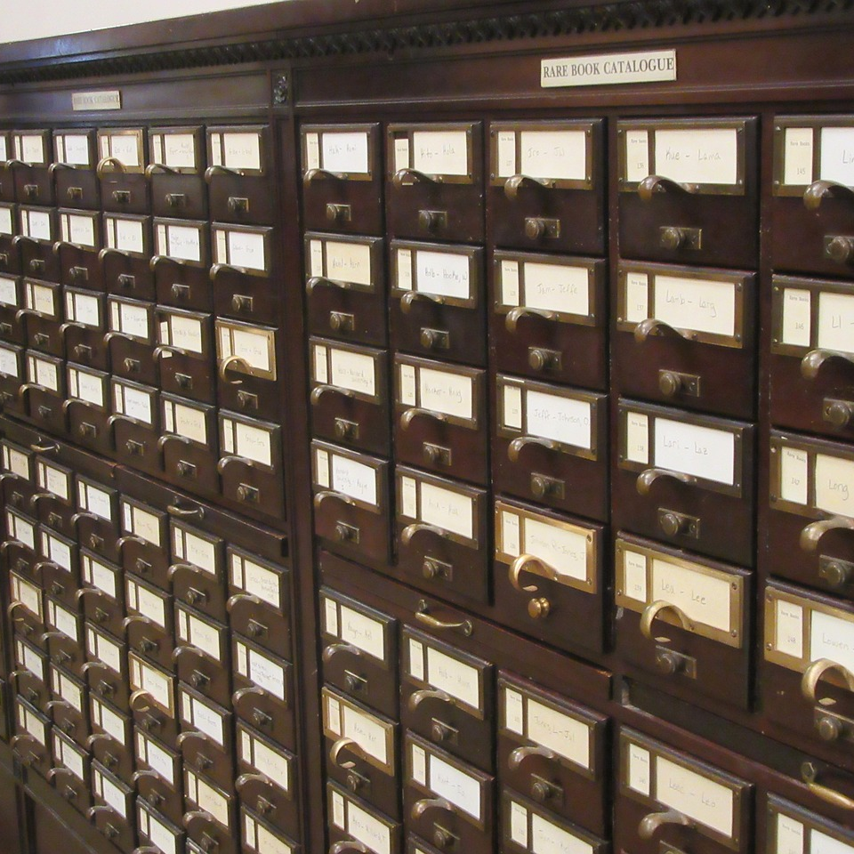
Meet your Librarian, SQL
Structured

Slide 22
Meet your Librarian, SQL
Structured
Query

Slide 23
Meet your Librarian, SQL
Structured
Query
Language

Slide 24

Are you ready for some baseball?
Lahman database: complete player statistics since 1871 plus salaries, Hall of Fame inductions and more!
Download here for SQLite.

Slide 25

Onward to SQLite!
+
Notes:
We will use SQLite Studio. You have to download both because SQLite sits on top of the source code of SQLite. This is like a “skin” if you are of a certain age.
SHOW HOW TO FIND THE NUMBER OF ROWS AND COLUMNS AND WHAT TYPE EACH COLUMN IS!

Slide 26
Are you ready for some drills?
How many columns are in Managers?
How many of these columns are of type INTEGER in Managers?
How many rows does Managers have?
Notes:
And I will give you a little more time so you can navigate what is going on here.

Slide 27
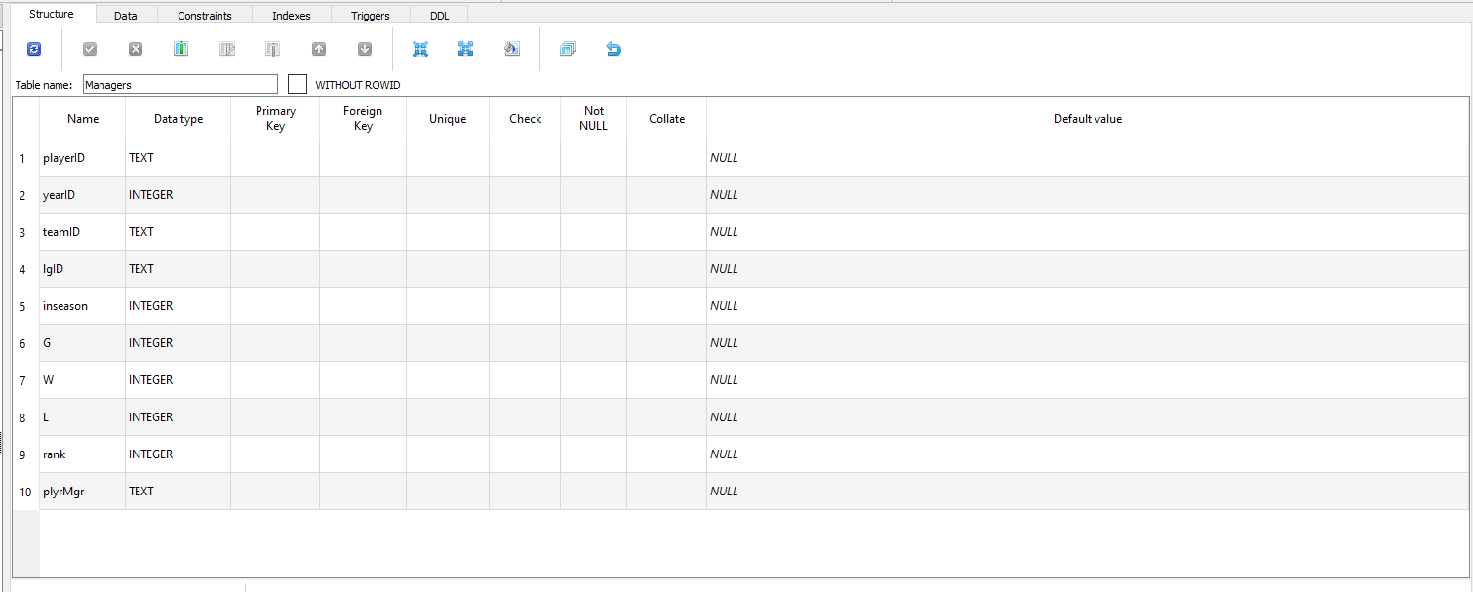
How many columns are in Managers?
Notes:
And I will give you a little more time so you can navigate what is going on here.

Slide 28
2. How many of these columns are of type INTEGER in Managers?
Notes:
And I will give you a little more time so you can navigate what is going on here.

Slide 29
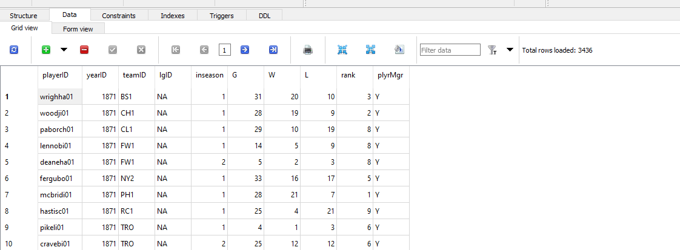
3. How many rows does Managers have?
Notes:
And I will give you a little more time so you can navigate what is going on here.

Slide 30
Questions?

Slide 31
SQL-Powered Excel
Month/Year

Slide 32
From Excel tables to SQL SELECT

Slide 33
From Excel-ese SQL-ese
Excel
Workbook
Worksheet
Columns
Rows

Slide 34
From Excel-ese SQL-ese
Excel
SQL
Workbook
Worksheet
Columns
Rows
Database
Table
Fields
Records

Slide 35
From Excel-ese SQL-ese
Excel
Data
Calculations
Notes

Slide 36
From Excel-ese SQL-ese
Excel
SQL
Data
Calculations
Notes
Tables
Queries/Scripts
Comments
Notes:
So while we have been doing

Slide 37
The grammar of SQL
Term What it does Example
Identifier | Identifies an object (i.e. table, field) | Master
Operator | Takes some action (perform calculation,, rename something) | +, AS
Expression | Applies criteria to data | birthYear > 1960

Slide 38

Stylin’ in SQL
0. Good comments starting with --

Slide 39
Stylin’ in SQL
0. Good comments starting with --
Each clause on its own line

Slide 40
Stylin’ in SQL
0. Good comments starting with --
Each clause on its own line
All operators uppercase

Slide 41
Stylin’ in SQL
0. Good comments starting with --
Each clause on its own line
All operators uppercase (SELECT, ORDER BY, etc.)
Statements end with semicolon (;)

Slide 42
Let’s get coding...
-- List all the tables in our database
SELECT name
FROM sqlite_master
WHERE type='table'
ORDER BY name;
--Get the name and data type from every field in the
--"master" table
PRAGMA table_info(master);
Notes:
Copy and paste this to your Lahman database.
This basically reproduces what we were doing with the GUI before.

Slide 43
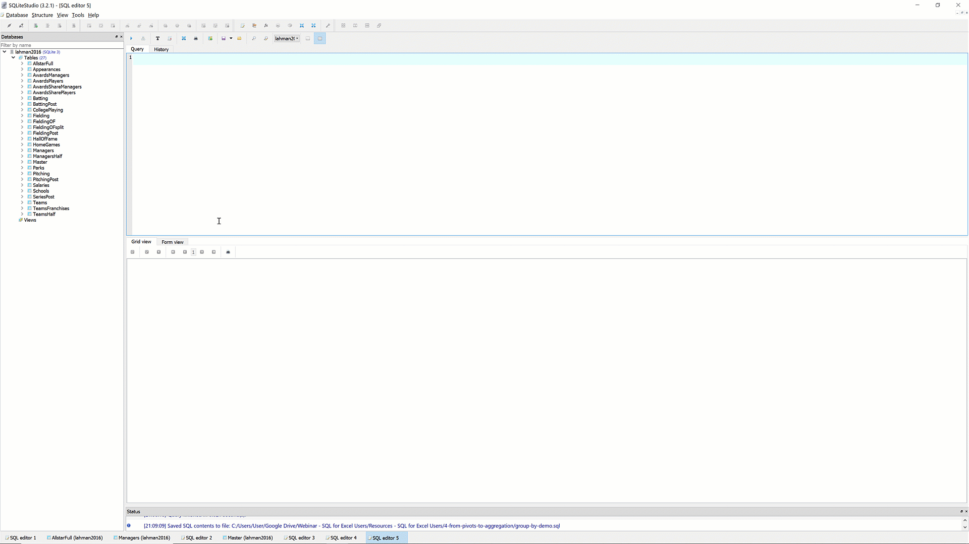
The font is too dang small!
Notes:
Copy and paste this to your Lahman database.
This basically reproduces what we were doing with the GUI before.

Slide 44
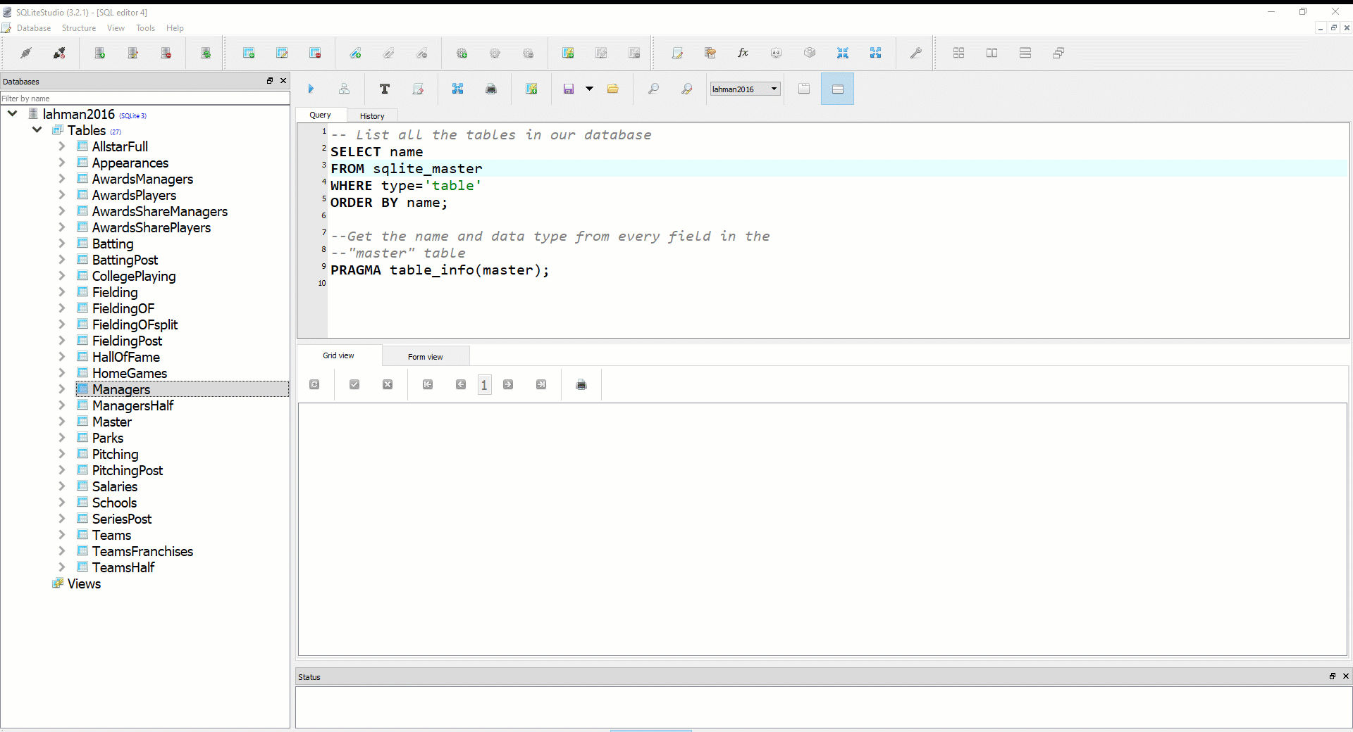
Saving your first .sql script
Notes:
Copy and paste this to your Lahman database.
This basically reproduces what we were doing with the GUI before.

Slide 45
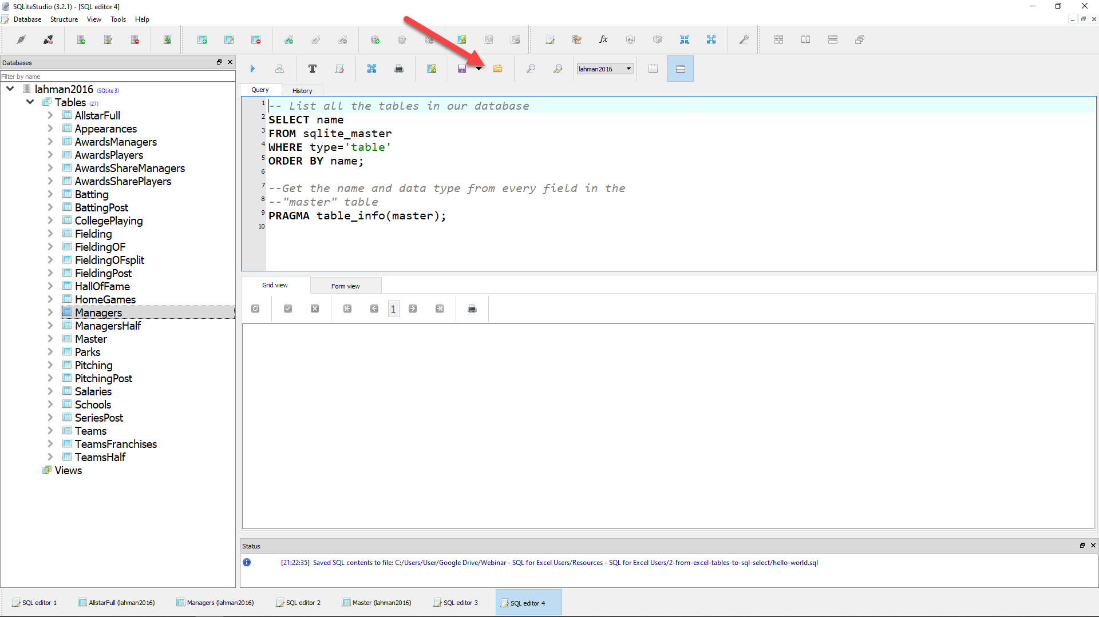
Loading your first .sql script
Notes:
Copy and paste this to your Lahman database.
This basically reproduces what we were doing with the GUI before.

Slide 46
The SQL Reader’s digest
Clause What it sets
SELECT | Which fields to look for
FROM | Where to look for those fields
WHERE | What criteria records should meet
GROUP BY | How to aggregate the results
HAVING | What criteria the aggregated results should meet
ORDER BY | How to sort the results
LIMIT | How many records to limit results to

Slide 47
Demo: sql-tables-example.xlsx

Slide 48
Demo: sql-select-demo.sql

Slide 49
Drills
Using the Teams table:
Select all fields.
Select all fields, first 100 rows.
Select yearID, teamID, W, L.
Select yearID, teamID, and a calculated field win_diff as the difference between W and L.
Create a field team_record such that the first record will read 1871 Boston Red Stockings: 20-10.

Slide 50
Drills
Using the Teams table:
Select all fields.
Select all fields, first 100 rows.
Select yearID, teamID, W, L.
Select yearID, teamID, and a calculated field win_diff as the difference between W and L.
Create a field team_record such that the first record will read 1871 Boston Red Stockings: 20-10.
Solutions: sql-select-drills.sql

Slide 51
Questions?

Slide 52
SQL-Powered Excel
Month/Year

Slide 53
From Sort & Filter to WHERE and ORDER BY

Slide 54
Demo: sort-filter.xlsx
Notes:
Sorting and filtering are unique operation

Slide 55
The SQL Reader’s digest
Clause What it sets
SELECT | Which fields to look for
FROM | Where to look for those fields
WHERE | What criteria records should meet
GROUP BY | How to aggregate the results
HAVING | What criteria the aggregated results should meet
ORDER BY | How to sort the results
LIMIT | How many records to limit results to

Slide 56
SQL WHERE: Comparison operators
Operator Description
= | Equal
< > , != | Not equal
> | Greater than
< | Less than
>= | Greater than or equal to
<= | Less than or equal to

Slide 57
SQL WHERE: Logical operators
Operator Description
BETWEEN | Between an inclusive range
IS NULL | Is a null value
IN | Specifies a range of conditions
OR | Avoids evaluating second condition if first is met
AND | Can be used with other operators
NOT | Excludes results

Slide 58

A note on NULLs
DOES
Indicate a missing value

Slide 59
A note on NULLs
DOES
DOES NOT
Indicate a missing value
Indicate a value of 0
Indicate why it’s missing

Slide 60
Demo: sort-filter-demo.sql
Notes:
Sorting and filtering are unique operation

Slide 61
Drills
Using the Managers table:
Select all records, sorted newest to oldest, then by playerID alphabetically.
Select all records between the 1991 and 2000 seasons, sorted high to low by number of games, G.
Create a field, win_diff, calculated as W - L. Return the records with the 25 highest values of win_diff.
How many missing values are in the rank field?

Slide 62
Drills
Using the Managers table:
Select all records, sorted newest to oldest, then by playerID alphabetically.
Select all records between the 1991 and 2000 seasons, sorted high to low by number of games, G.
Create a field, win_diff, calculated as W - L. Return the records with the 25 highest values of win_diff.
How many missing values are in the rank field?
Solutions: sql-filter-drills.sql

Slide 63
Questions?

Slide 64
SQL-Powered Excel
Month/Year

Slide 65
From SUM() and SUMIF() to Aggregation

Slide 66
Basic arithmetic functions in SQL
Function What it does
SUM() | Which fields to look for
AVG() | Where to look for those fields
MIN() | What criteria records should meet
MAX() | How to sort results
COUNT() | How to aggregate the results

Slide 67
Basic string functions in SQL
Function What it does
CONCAT() | Concatenate fields together
LEFT() | Return left X values from a string
RIGHT() | Returns right X values from a string
UPPER() | Returns string capitalized
LOWER() | Return lowercase string

Slide 68
Exploring fields and records in SQL
Function/operator What it does
COUNT(X) | Count all records of a field X
DISTINCT X | List distinct values of a field X
COUNT(DISTINCT X) | Count distinct values of a field X

Slide 69
Demo: aggregation-demo.xlsx

Slide 70
Demo: aggregation-demo.sql

Slide 71
Drills
Using the Teams table:
Select the maximum and minimum number of runs.
Select the total number of home runs between 2000 and 2010: total_homers.
Count records where games played is NULL.
Count records with a recorded attendance.
Return a list of all years included in the table
Count the number of unique franchises since 1915.

Slide 72
Drills
Using the Teams table:
Select the maximum and minimum number of runs.
Select the total number of home runs between 2000 and 2010: total_homers.
Count records where games played is NULL.
Count records with a recorded attendance.
Return a list of all years included in the table
Count the number of unique franchises since 1915.
Solutions: aggregation-drills.sql

Slide 73
Questions?

Slide 74
From PivotTables to GROUP BY

Slide 75
The SQL Reader’s digest
Clause What it sets
SELECT | Which fields to look for
FROM | Where to look for those fields
WHERE | What criteria records should meet
GROUP BY | How to aggregate the results
HAVING | What criteria the aggregated results should meet
ORDER BY | How to sort the results
LIMIT | How many records to limit results to

Slide 76
Demo: group-by-demo.xlsx

Slide 77
Demo: group-by-demo.sql

Slide 78
Drills
Using the Teams table:
Return the largest attendance for each team, sorted high to low.
Find the total number of stolen bases, grouped by year and league.
Find the average number of home runs for each season, keeping only years with an average of 150 home runs or more.

Slide 79
Drills
Using the Teams table:
Return the largest attendance for each team, sorted high to low.
Find the average number of home runs for each season, keeping only years with an average of 150 home runs or more.
Solutions: group-by-drills.sql

Slide 80
SQL-Powered Excel
Month/Year

Slide 81
Intermezzo: All clauses in one

Slide 82
The SQL Reader’s digest
Clause What it sets
SELECT | Which fields to look for
FROM | Where to look for those fields
WHERE | What criteria records should meet
GROUP BY | How to aggregate the results
HAVING | What criteria the aggregated results should meet
ORDER BY | How to sort the results
LIMIT | How many records to limit results to

Slide 83

And now you’ll never forget...
SWEATY | SELECT
FEET | FROM
WILL | WHERE
GIVE | GROUP BY
HORRIBLE | HAVING
ODORS | ORDER BY

Slide 84

And now you’ll never forget...
SWEATY | SELECT nameFirst, COUNT(nameFirst)
FEET | FROM Master
WILL | WHERE birthCountry != ‘USA’
GIVE | GROUP BY nameFirst
HORRIBLE | HAVING COUNT(nameFirst) > 1
ODORS | ORDER BY COUNT(nameFirst) DESC;

Slide 85
Drills
Using the Teams table:
Find the maximum number of home runs hit by a team for each year since 1980. Include only those years where fewer than 200 home runs were hit by any team. Sort the results from high to low.
For NL teams that won the World Series that year, what was the maximum number of games won? Include only those teams that won at least 100 games for one of those years. Sort the results from high to low.

Slide 86
Drills
Using the Teams table:
Find the maximum number of home runs hit by a team for each year since 1980. Include only those years where fewer than 200 home runs were hit by any team. Sort the results from high to low.
For NL teams that won the World Series that year, what was the maximum number of games won? Include only those teams that won at least 100 games for one of those years. Sort the results from high to low.
Solutions: sql-all-statements-in-one-drill.sql

Slide 87
SQL-Powered Excel
Month/Year

Slide 88
From VLOOKUP() to SQL JOIN

Slide 89

How do we get information from more than one table at a time?
What makes a relational database, relational?
https://dev.to/helenanders26/sql-series-all-about-sql-joins-15ol

Slide 90

Shout-out to Power Query!
From Office Support: “Power Query enhances self-service business intelligence (BI) for Excel with an intuitive and consistent experience for discovering, combining, and refining data across a wide variety of sources including relational, structured and semi-structured, OData, Web, Hadoop, and more.”
Notes:
And I wanted to show this to you guys but don’t want to exclude anybody.

Slide 91
Shout-out to Power Query!
From Office Support: “Power Query enhances self-service business intelligence (BI) for Excel with an intuitive and consistent experience for discovering, combining, and refining data across a wide variety of sources including relational, structured and semi-structured, OData, Web, Hadoop, and more.”
Including relational databases & SQL!
Notes:
And I wanted to show this to you guys but don’t want to exclude anybody.

Slide 92

Shout-out to Power Query!
From Office Support: “Power Query enhances self-service business intelligence (BI) for Excel with an intuitive and consistent experience for discovering, combining, and refining data across a wide variety of sources including relational, structured and semi-structured, OData, Web, Hadoop, and more.”
Including relational databases & SQL!
But not yet for Mac … stay tuned!
Notes:
And I wanted to show this to you guys but don’t want to exclude anybody.

Slide 93
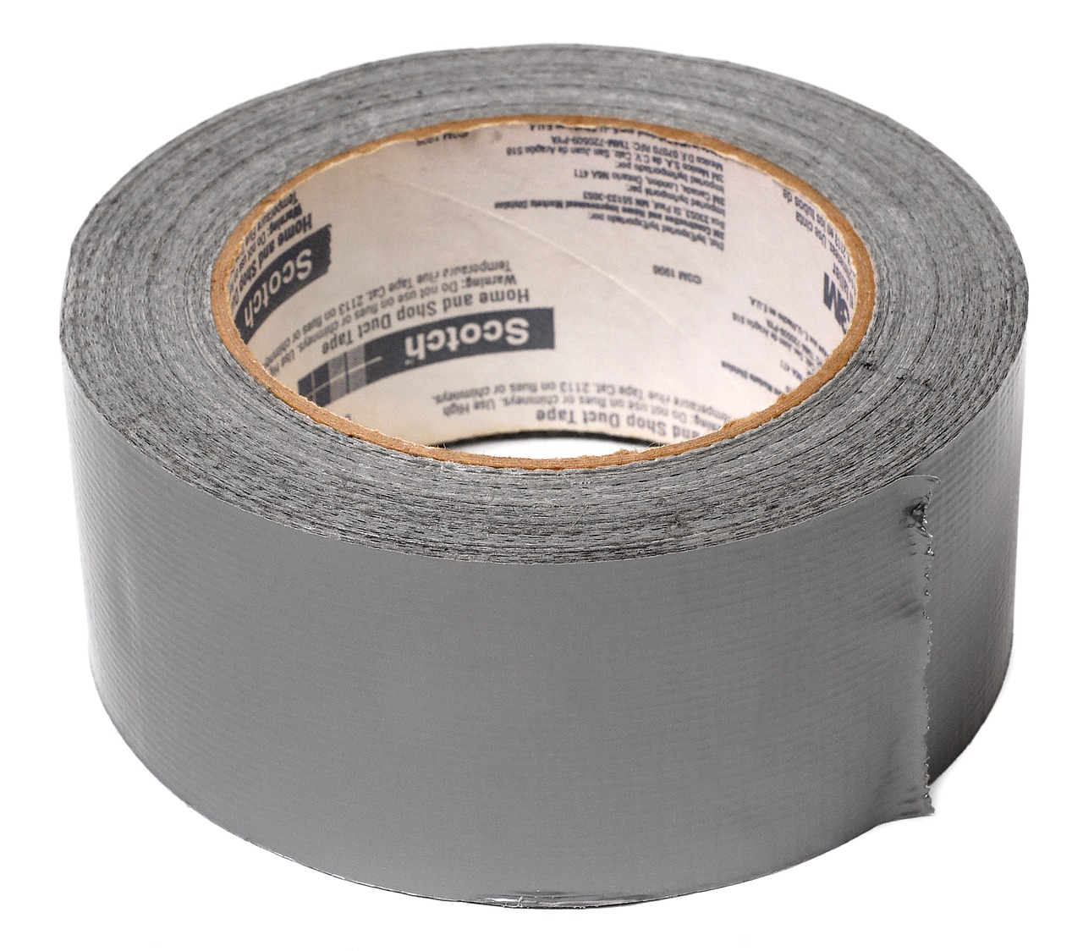

FROM VLOOKUP() Duct Tape to JOIN Blowtorch

Slide 94
Demo: vlookup-vs-join.xlsx

Slide 95
Putting the relationships into relational databases

Slide 96

Key-Lookup
Primary key: Unique, unchanging identifier
Foreign key: References the primary key of another table

Slide 97

If you’ve ever been asked for an ID number...
...You’ve been asked for your primary key!

Slide 98
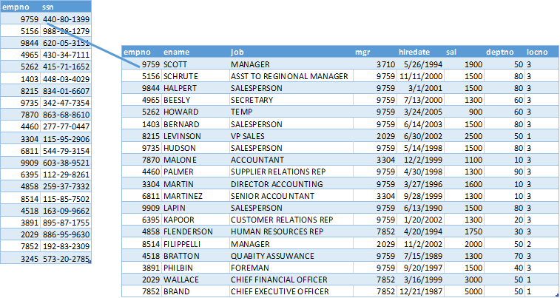
One-to-one relationship, William Charles Schneider excluded
Notes:
And I wanted to show this to you guys but don’t want to exclude anybody.

Slide 99
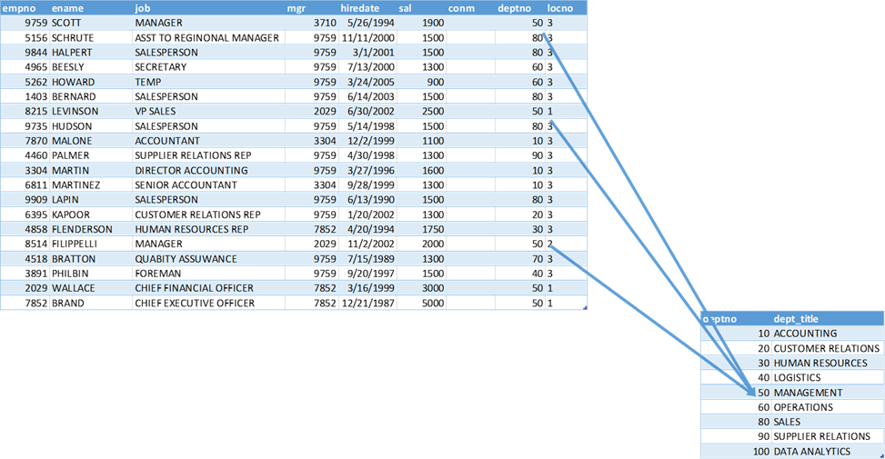
One-to-many relationship

Slide 100
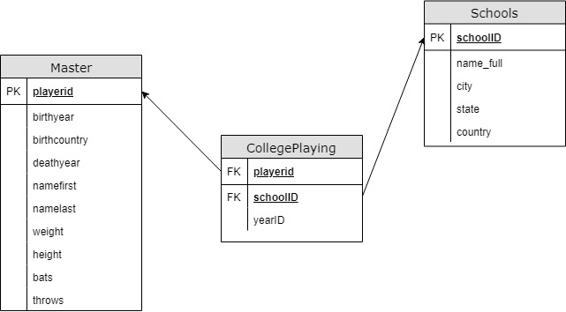
Introducing Schemas

Slide 101
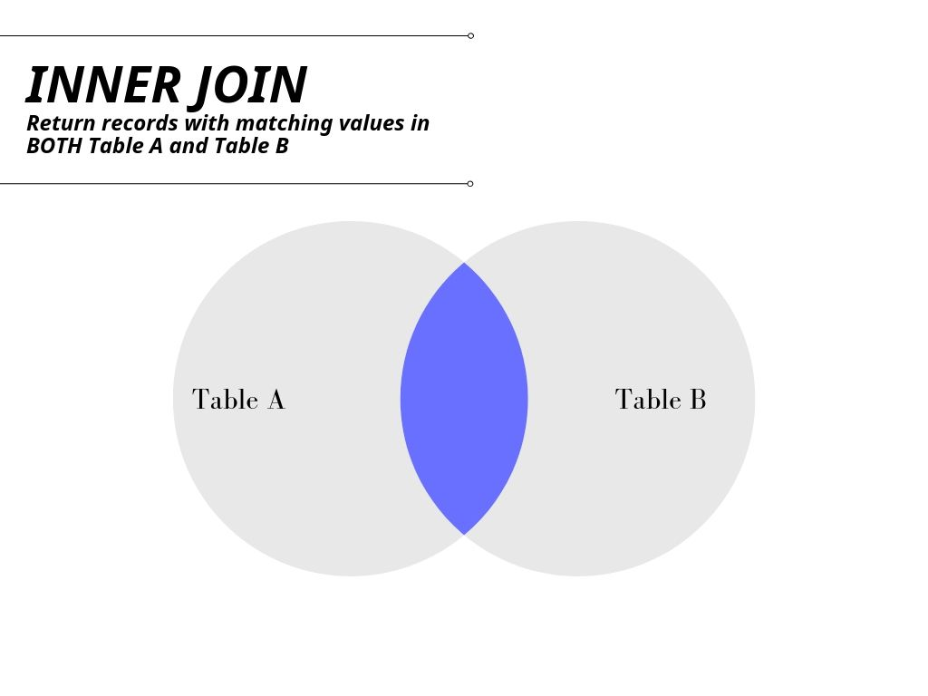

Slide 102
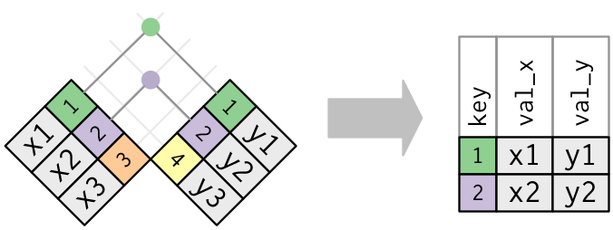
Another way to look at it…
Wickham & Grolemund, R for Data Science. Available at https://learning.oreilly.com/library/view/r-for-data/9781491910382/

Slide 103
Demo: inner-join-demo.sql

Slide 104
Drills -- INNER JOIN
For the Master and HallOfFame tables:
Return a list of unique first and last names for all individuals in .HallOfFame
Return first and last names along with the year, votes needed and votes received for all successful HoF inductees
Return the birth year of the oldest individual inducted for each year of HoF inductions. How “old” was each player at induction?
Notes:
I am going to ratchet up the difficulties on these a little more.

Slide 105
Drills -- INNER JOIN
For the Master and HallOfFame tables:
Return a list of unique first and last names for all individuals in .HallOfFame
Return first and last names along with the year, votes needed and votes received for all successful HoF inductees
Return the birth year of the oldest individual inducted for each year of HoF inductions. How “old” was each player at induction?
Solutions: inner-join-drills.sql
Notes:
I am going to ratchet up the difficulties on these a little more.

Slide 106
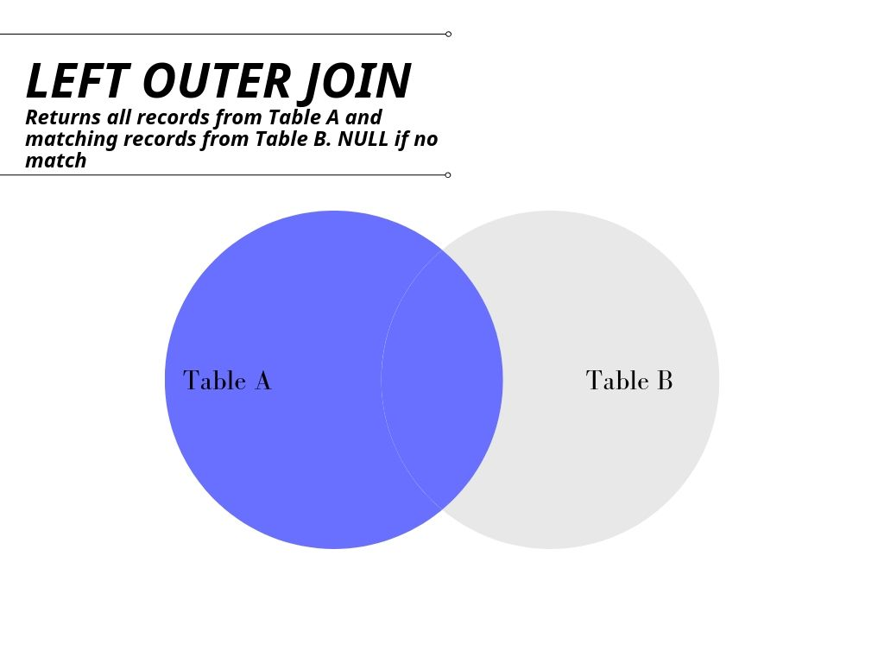

Slide 107
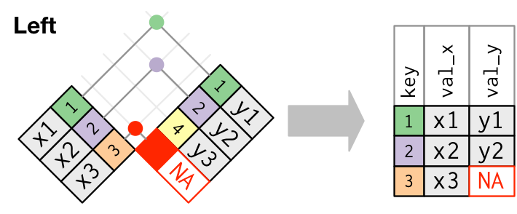
Another way to look at it…
Wickham & Grolemund, R for Data Science. Available at https://learning.oreilly.com/library/view/r-for-data/9781491910382/

Slide 108
Demo: left-outer-join-demo.sql

Slide 109
Drills -- LEFT OUTER JOIN
Find the maximum annual salary paid to anyone included in Master, sorted descending by salary.
Keeping the names of all schools listed in Schools, find the first name, last name and years played for all schools (Check CollegePlaying).
Notes:
I am going to ratchet up the difficulties on these a little more.

Slide 110
Drills -- LEFT OUTER JOIN
Find the maximum annual salary paid to anyone included in Master, sorted descending by salary.
Keeping the names of all schools listed in Schools, find the first name, last name and years played for all schools (Check CollegePlaying).
Solutions: left-outer-join-drills.sql
Notes:
I am going to ratchet up the difficulties on these a little more.

Slide 111
Thank you

Slide 112
SQL-Powered Excel
Month/Year

Slide 113
From That’s hard in Excel to That’s Easy in SQL

Slide 114
Demo: hard-in-excel-easy-in-sql.xlsx

Slide 115
Demo: hard-in-excel-easy-in-sql-demo.sql

Slide 116
CASE expressions
CASE
WHEN condition THEN result-expression
WHEN condition THEN result-expression ...
ELSE result-expression
END AS alias

Slide 117
Subqueries as a condition: WHERE
SELECT fields
FROM table
WHERE operator
-- Subquery
(SELECT fields
FROM table);

Slide 118
Common table expressions (CTEs): Expressions acting like tables
WITH
expression_name_1 AS
(CTE query definition 1)
SELECT expression_A, expression_B, ...
FROM expression_name_1

Slide 119
Drills
Using the Teams table:
What teams had more wins than the 2016 Chicago Cubs (teamID = ‘CHN’)?
Create a field Century which marks records in the 19th Century as 19, 20th as 20 and 21st as 21.
Find the average season minimum attendance since 1990.
Notes:
And you can use your own search criteria for these, We will go by record count.

Slide 120
Drills
Using the Teams table:
What teams had more wins than the 2016 Chicago Cubs (teamID = ‘CHN’)?
Create a field Century which marks records in the 19th Century as 19, 20th as 20 and 21st as 21.
Find the average season minimum attendance since 1990.
Solutions: hard-in-excel-easy-in-sql-drills.sql
Notes:
And you can use your own search criteria for these, We will go by record count.

Slide 121
Questions?

Slide 122
SQL-Powered Excel
Month/Year

Slide 123
SQL: The Prequel
Conclusion & resources

Slide 124

Learning SQL, 2nd Edition
by Alan Beaulieu
On O’Reilly Learning at https://www.oreilly.com/library/view/learning-sql-2nd/9780596801847/

Slide 125

SQL Cookbook
by Anthony Molinaro
On O’Reilly Learning at https://www.oreilly.com/library/view/learning-sql-2nd/9780596801847/

Slide 126
Find me
georgejmount.com
@gjmount
github.com/summerofgeorge

Slide 127
Thank you

